Slide 1
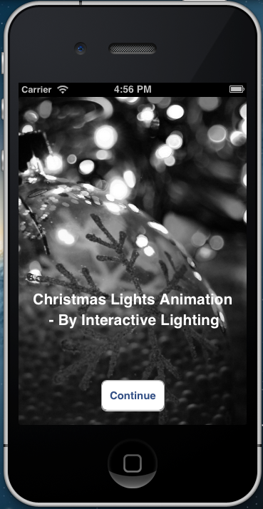

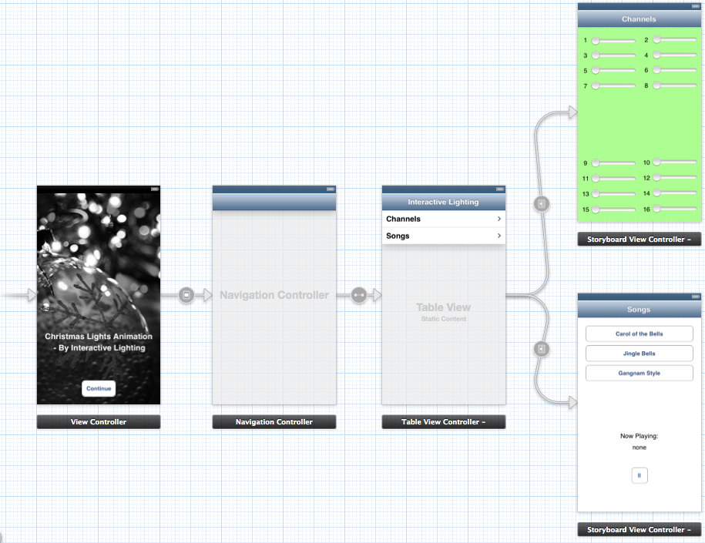

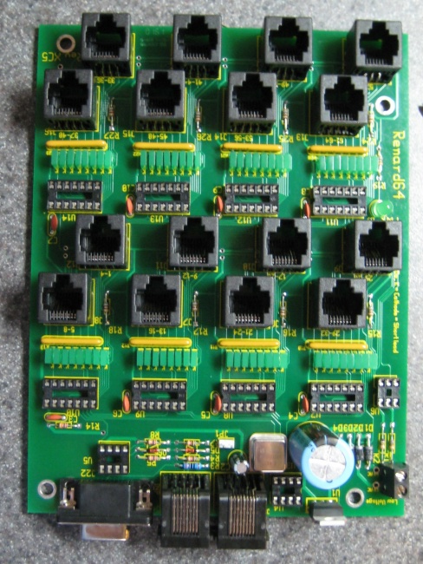
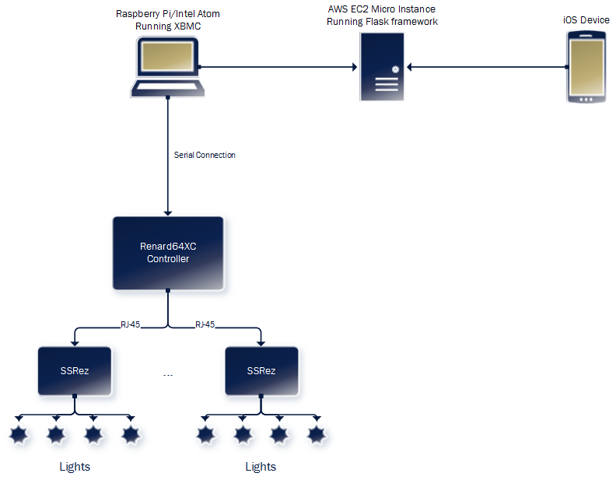
Christmas Lights Animation By: Austin Wentz and Jordan Doell Sponsor: L3 Communications ScrumMaster: Dr. McGough
iOS Application
Client Application
Hardware
iPhone® app
“Controls the system”
Sends commands to the server
Play a song
Pause a song
Can change each channel’s brightness
Sends commands using JSON data format
XBMC Plugin
Designed for network playback and supports almost all audio and video formats
Includes a built-in Python interpreter which allows users to develop add-ons
Works on Linux, OSX, & Windows
Renard 64XC SSRez
Architecture
Server
Amazon EC2 instance running Ubuntu
Mobile device sends notifications or requests to the EC2 server.
Computer connected to lighting controller queries EC2 instance for new information.
Prevents having any issues with firewalls, network configuration, etc.

